Slide 1
Phylogenetics of animal pathogens: basic principles and applications
Dr EP de Villiers
Adapted from: http://viralzone.expasy.org/

Slide 2
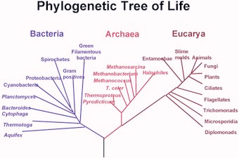
Tree basics
The Concept of Phylogenetic Tree
Trees Capture Major Events in a Species' Existence
A tree is composed of Leaves, Branches, and Inner Nodes
Branch Lengths can also Reflect Distance
Kinship, Cladograms, and Clades
There can be Trees of Genes as well

Slide 3
Evolving the Concept of Phylogenetic Tree
There are two ways to introduce phylogenetic trees:
the "theorist's approach", in which one starts with a definition, then demonstrates properties and illustrates with examples, as is often done in mathematics;
the "experimentalist's approach", in which one starts with examples, observes properties, and generalizes to eventually approach an intuitive definition, as would an experimental scientist.
It is surprisingly difficult to give a definition of phylogenetic trees that is both correct and general and not utterly obscure for non-experts.
We will follow the second approach: we will show some examples of trees, observe their properties, and gradually refine our understanding until it is sufficient to interpret and construct trees for research purposes. We will start with the most intuitive concepts, even if they turn out to be less frequently used in phylogenetics, and use them as stepping stones to the more elaborate notions.
A precise definition of exactly what trees are can be left to mathematicians, at least for now . No prior knowledge of trees is required.

Slide 4
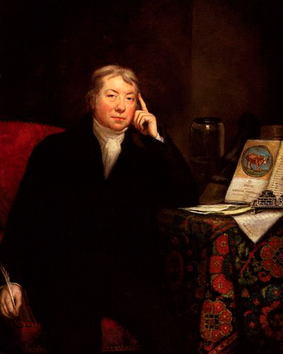
Trees Capture Major Events in a Species' Existence (1/3)
Let us follow the fate of a viral species. To start on familiar ground, we shall look at the vaccinia virus, the first vaccine isolated by Jenner in 1796, its immediate ancestors and close relatives. We will address only the most important events in a species history:
splitting : a viral lineage (this term will be defined later) splits into two separate lineages.
extinction : a lineage disappears
Edward Jenner
Smallpox vaccine

Slide 5
Trees Capture Major Events in a Species' Existence (2/3)
Here is a possible scenario :
At the beginning, there is only one species of poxvirus.
About ten thousand years ago, that lineage splits into two lineages, which eventually will give rise to cowpox and variola.
In 1796 Edward Jenner isolates a cowpox virus and creates the first vaccine.
In 1980 variola virus, the agent of smallpox is officially eradicated.
This is summarized in Table 1:
Date | Event
Until 10,000 years ago | Beginning. One poxvirus lineage present
~10,000 years ago | Poxvirus lineage split
1796 | Vaccinia splits from cowpox
1980 | Eradication of variola virus, the agent of smallpox

Slide 6
Trees Capture Major Events in a Species' Existence (3/3)
If we represent a viral lineage' life span as a horizontal line, each species at a different height, and represent splits by vertical lines, we obtain the graphics shown in Figure 1.
Figure 1. A representation of the scenario shown in Table 1. Time is on the horizontal axis, with the present time on the right.
This is our first encounter with a phylogenetic tree and it is a graphical representation of splitting and extinction, in a viral lineage, over time.

Slide 7
Quiz
In the tree of Figure 1, which virus is vaccinia more closely related to?
What is the earliest date represented in the tree of Figure 1?
Notes:
Cowpox
10,000 years

Slide 8
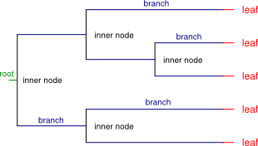
A tree is composed of Leaves, Branches, and Inner Nodes (1/2)
The oldest species in the tree is called the root.
a leaf represents a species with no descendants. This is usually because it is still in existence or because it went extinct before leaving daughter species . Leaves are also called tips.
an inner node represents a speciation event, in which a viral species splits into two daughter species.
branches show the life span of a species. The branch starts when the virus appears, which is during a speciation event. The branch ends either in a split (inner node) or in a leaf.
The parts of a phylogenetic tree

Slide 9
A tree is composed of Leaves, Branches, and Inner Nodes (2/2)
An inner node connects two daughter species or virus progeny (on the right of Figure 2) with their parent (on the left of Figure 2). Each species in the tree thus has exactly one parent, except the root, which has none. Each species has either two daughters, or zero.
Daughter species can have daughters of their own and so on. Daughters and their own daughters, etc. are called descendants; parents and their parent, etc. are called ancestors. A group of species which are all ancestors or descendants of one another is called a lineage. The root, then, is the ancestor of all species in the tree, and it belongs to every lineage. It is the only node with these properties.
It is frequently the case that the root's branch length is unknown (this is because of tree reconstruction techniques. In this case, the root is just marked by a short line.

Slide 10
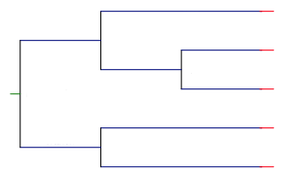
Quiz
How many leaves does the tree have?
How many inner nodes does the tree have?
Can two different leaves belong to the same lineage?
Notes:
5 leaves
4 inner nodes
No, the two leaves are not ancestors or descendants of one another

Slide 11
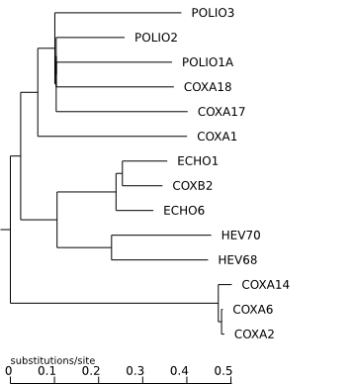
Branch Lengths can also Reflect Distance (1/2)
Whenever a lineage splits, its children evolve on separate paths, each accumulating mutations, and the number of changes since the split grows with time. Given a pair of viral lineages, the number of mutations accumulated since they split gives us a measure of how different they are. This is known as genetic distance.
Tree representation where branch length represents genetic distance.
Notes:
Is the ratio between time and number of mutations constant?
No, the ratio is likely to vary across lineages , and even within one lineage it is not necessarily constant over time and this can be represented by the branch length. Differences in population size, generation time, and selective pressure all contribute to this variation. Thus, since mutation rates vary, some branches will be longer than others of the same age. For example, in the tree of enteroviruses shown in Figure 3, POLIO2 has a much shorter branch than POLIO1A, even though they are exactly the same age. This means that POLIO2 has accumulated fewer mutations.

Slide 12
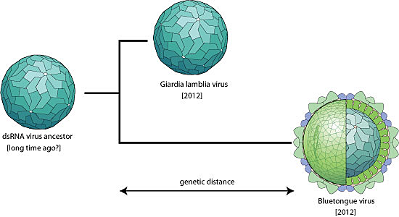
Branch Lengths can also Reflect Distance (2/2)
We have seen that the length of branches may reflect genetic distance instead of time.
Trees measured in time units are actually rare, because inferring dates is difficult and often not necessary.

Slide 13
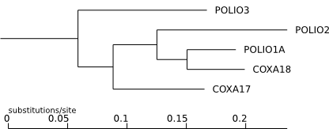
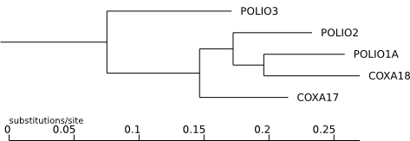
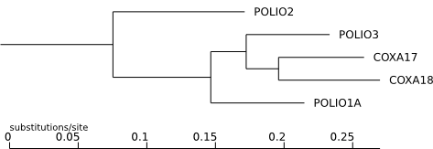
Kinship, Cladograms, and Clades (1/5)
(a)
Compare trees (a) and (b) of Figure 4.
Now compare trees (b) and (c).
Which pair looks more similar?
Trees (a) and (b) have different branch lengths, but they represent the same biological events: POLIO3 first splits from the rest, then COXA17 splits, etc; the closest relative of POLIO1A is COXA18, etc.
(b)
(c)
Notes:
By contrast, trees (b) and (c) look superficially similar because they have the same branch lengths, but they reflect different events: in tree (c), POLIO2 splits first from the rest, then POLIO1A, etc.; and the closest relative of POLIO1A is the whole POLIO3 - COXA17 - COXA18 group. In fact, the similar-looking branch lengths are misleading, and the trees depict different evolution scenarios..
As we have seen, trees represent major events in a virus' existence, so we conclude that similar trees must represent similar events. Tree (b) is much more similar to tree (a), and trees (b) and (c) share very little, apart from accidental branch length similarity, and the overall list of viruses.

Slide 14
Kinship, Cladograms, and Clades (2/5)
if we ignore branch lengths altogether, trees (a) and (b) are identical. There is a class of phylogenetic trees that have exactly this property: they are called cladograms (if branch lengths are significant, the tree is called a phylogram). Figure 2 show the tree of Figure 1 as a cladogram.
Figure 1: phylogram
Figure 2: cladogram

Slide 15
Kinship, Cladograms, and Clades (3/5)
In a cladogram, branch lengths carry no information, and only the relative horizontal position of nodes in the same lineage is informative. For this reason, leaves in a cladogram are usually aligned to improve readability, not to indicate equal genetic distance or age. For the same reason, cladograms do not feature scale bars.

Slide 16
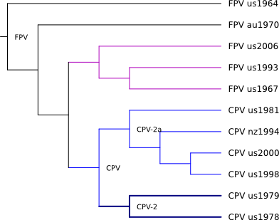
Kinship, Cladograms, and Clades (4/5
This cladogram show that the Feline parvovirus (FPV) is older than the Canine parvovirus (CPV), because the former is an ancestor of the latter (CPV evolved from FPV).
It would be wrong to conclude from the fact that CPV-2 and CPV-2a are aligned, that they are equally old (or equally distant from the root): the alignment is just an artifact of drawing, and carries no information.
Notes:
CPV us1998 have split from CPV us2000 before splitting from CPV nz1994: False
Canine parvovirus are descended from feline parvovirus: True
Canine parvovirus are descended from one of the FPV ... shown in the leaves of the tree: True
FPV us 2006 and CPV us 2000 form a clade.: False
CPV us 1998, CPV us 2000, CPV nz 1994 and CPV us 1981 form a clade: True

Slide 17
Trees are not Graphics (1/3)
Although the graphics are different, the information is the same.
Top: identical to Figure 1; bottom: the same but in reverse order.

Slide 18
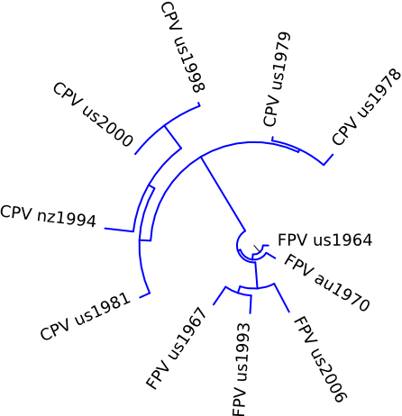
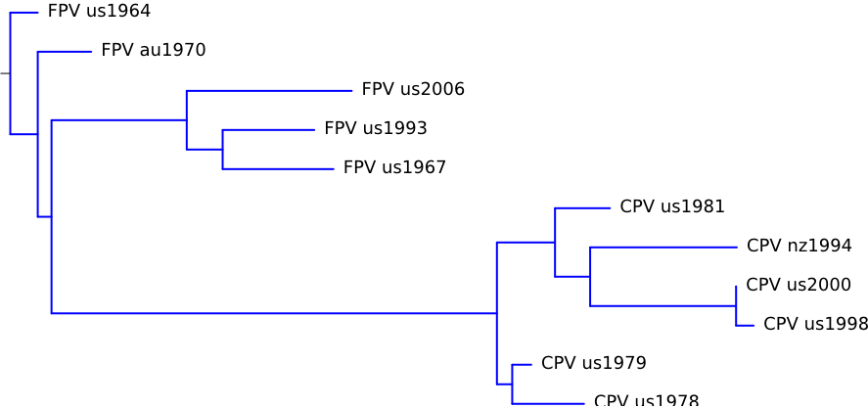
Trees are not Graphics (2/3)
Likewise, the following figures represent the same tree - what changes is the style, not the information.
The two panels show the same tree, but in different styles.
The tree on the right is in radial style: branches are along radii, and splits are arcs.

Slide 19
Trees are not Graphics (3/3)
Trees and tree graphic representation are different things, and we revise our concept of "tree" to mean an abstract representation of the clades found in a group of viruses, possibly including information about age or genetic distance. Trees can be represented in many ways, including as graphics . This distinction has practical consequences: a frequent error in tree interpretation involves failure to recognize that two graphics actually represent the same tree.

Slide 20
There can be Trees of Genes as well
Ancestry relationships are not limited to species. Ancestry is found for example:
in genes: two genes are homologs if they derive from a common ancestor
in cells: a parent cell divides in two daughter cells
even outside biology, e.g. modern languages are descended from older ones.
Phylogenies exist everywhere ancestry relationships exist, and have been reconstructed in all of these cases. For virology, however, the most frequent uses by far are trees of viral genomes or proteins.

Slide 21
Kinship, Cladograms, and Clades (5/5)
A cladogram thus retains only the essential information: which viruses are most closely related to which, or, equivalently, which viruses share an ancestor not shared by any other. Such groups are called clades and are a fundamental concept in phylogenetics.
A clade is an ancestor and all its descendants.
Kinship, in the form of clades, is the essential information conveyed by trees, and that some kinds of trees (cladograms) contain nothing else, while others (phylograms) contain additional information in the branch lengths.

Slide 22
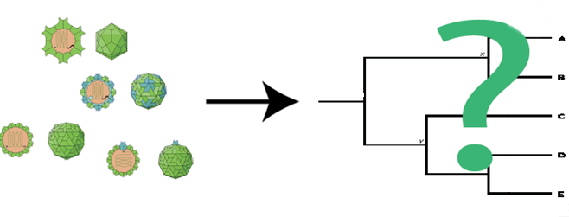
Building Phylogenetic Trees

Slide 23
The Task: Finding Phylogenetic Relationships
Is there always a Tree?
is widely accepted that cellular organisms all stem from a common ancestor, so if all our species are cellular, the answer is a clear yes.
That is why we speak of the "Tree of Life".
For genes, it will be possible if (and only if) they are homologous
Homologs refer to genes that share a common ancestor.

Slide 24
The Task: Finding Phylogenetic Relationships
Is there only one Tree?
To a large extent, yes, but there are notable exceptions. For example, a hybrid species, such as the mule, has two parents (horse and donkey). Recombinant and reassortant viruses are another example.
In cases, where the single-parent hypothesis is not true, it is possible to compute a tree, but they can lower the quality of the resulting phylogenies.
We usually speak of the phylogeny of a group of species – and attempt to compute it.

Slide 25
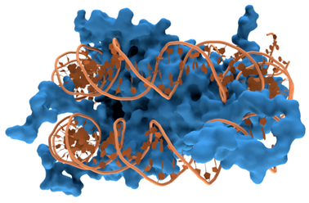
The Task: Finding Phylogenetic Relationships Input
In principle, any heritable trait can be used. In practice, and in particular for virology, this almost always means molecular sequences. Both amino acids and nucleotides can be used.
DNA (shown in orange) with histones (shown in blue)

Slide 26
The Task: Finding Phylogenetic Relationships Output
What do Tree-computing programs produce?
Trees are not graphics, but abstract representations of phylogenetic relationships.
Tree-building programs do not produce graphics.
They typically produce a text file containing a symbolic representation of a tree, such as this one:
(FPV_us1964:0.00036,(FPV_au1970:0.0007,((FPV_us2006:0.00216,(FPV_us1993:0.00120,
FPV_us1967:0.00145)0.87:0.00047)0.97:0.00177,((CPV_us1981:0.00072,(CPV_nz1994:0.
00192,(CPV_us2000:0.0,CPV_us1998:0.00023)0.99:0.00191)0.82:0.00046)0.92:0.00076,
(CPV_us1979:0.00025,CPV_us1978:0.00094)0.76:0.0002)1:0.00583)0.72:0.00018):0.000
36);

Slide 27
The Task: Finding Phylogenetic Relationships
This can then be represented (after rooting), e.g. like this:
/-+ FPV us1964
|
| /----+ FPV au1970
=+ |
| | /--------------+ FPV us2006
| | |
\-+ /-----------+ /-------+ FPV us1993
| | \--+
| | \---------+ FPV us1967
| |
\-+ /----+ CPV us1981
| |
| /----+ /------------+ CPV nz1994
| | | |
| | \--+ / CPV us2000
\---------------------------------------+ \------------+
| \-+ CPV us1998
|
|/-+ CPV us1979
\+
\------+ CPV us1978
|-------------|-------------|------------|-------------|------------
0 0.002 0.004 0.006 0.008
substitutions/site
Some programs will perform this step automatically. The advantage is that the user does not need to explicitly launch a separate viewing program; the downside is that graphics cannot be further processed. If you then need to do anything with the tree (for example if you are studying evolutionary rates and need to extract branch lengths), you will need the symbolic form.

Slide 28
The Task: Finding Phylogenetic Relationships
Where is the Root?
Most tree-building methods cannot identify the tree's root, and thus produce unrooted trees.
Unrooted trees are not real phylogenetic trees (does not know which node is the ancestor of which).
To obtain true phylogenies, one must root the tree. There are a few ways of doing this:
mid-point rooting take the two species with the largest distance of any pair of species, and set the root halfway between them.
longest-branch rooting find the longest branch in the tree, and set the root at its middle.
outgroup rooting add a related species (called the outgroup) to an analysis, and set the root at the middle of the branch that connects the outgroup with the rest (which is called the ingroup).

Slide 29
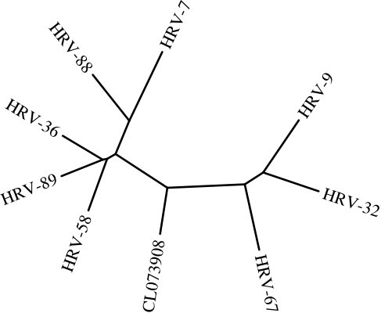
The Task: Finding Phylogenetic Relationships
Example of outgroup rooting, the most common method.
Cannot tell which node is an ancestor of which.
The root of the tree could be in any of the branches. It may be for example, that CL073908, HRV-9, HRV-32 and HRV-67 form a clade - but until the position of the root is known, this can be neither confirmed nor ruled out.
An unrooted tree of Enterovirus 3'-UTR

Slide 30
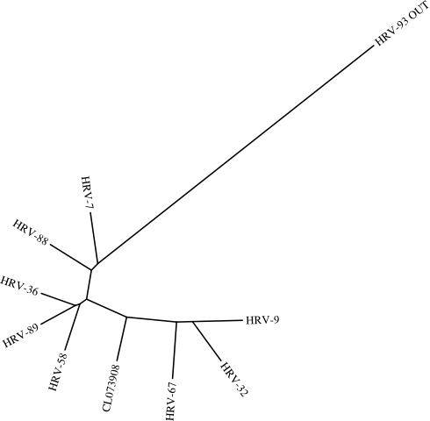
The Task: Finding Phylogenetic Relationships
A tree made with the same sequences plus that of a more distantly related virus, HRV-93 (labeled "OUT").
The outgroup is connected to the rest of the tree in the branch that connects HRV-7 to the rest of the tree in
Tree of Enterovirus 3'-UTR with outgroup

Slide 31
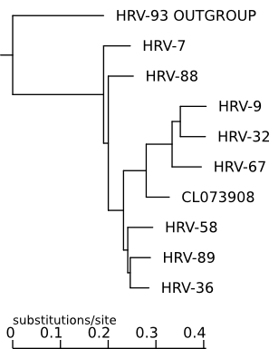
The Task: Finding Phylogenetic Relationships
Can now represent the tree in the usual way.
The figure shows the outgroup, but once the root is known, the outgroup serves no further purpose and can be omitted (this may help viewing the tree if the outgroup is very distant from the rest).
HRV-7 is basal to the rest, that CL073908, HRV-9, HRV-32 and HRV-67 form a clade, etc - all of which the unrooted tree could suggest but not prove.
Phylogram of Enterovirus 3'-UTR with outgroup

Slide 32
The Task: Finding Phylogenetic Relationships
What to choose for the Outgroup?
There are two requirements for the outgroup:
It should absolutely not belong to the group under study, otherwise the tree's topology will be hopelessly wrong
It should not be too distantly related either, because it must be aligned with the other sequences. If it is too distantly related, the alignment quality may suffer.
In conclusion, a good outgroup would be a member of a sister clade.
For example to produce a phylogeny of FMDV, one would choose another Picornavirus. But the sister clade of the group under study may not be known, and it may be safer in this case to choose a more distant relative.

Slide 33
The Procedure
In short, building a tree involves the following steps (variants are possible):
Align the sequences (including the outgroup, if necessary)
Choose a tree-building method and program
Launch the build
Check the tree's validity
Alignment is included in this procedure because phylogenetic analyses usually start with unaligned sequences.
The choice of the tree-building methods is dictated by several factors, among which:
the number of sequences
the length of the sequences
the desired level of quality
additional knowledge and assumptions about the sequences

Slide 34
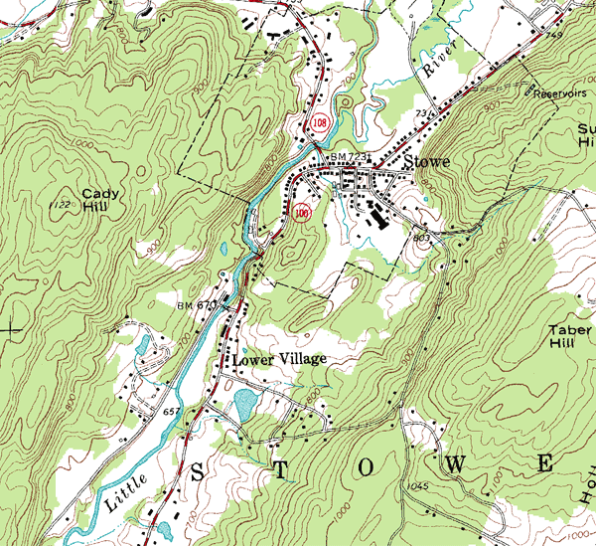
Tree Construction Methods
An Analogy: Finding Peaks on a Map
Notes:
Suppose you are given a map (Figure 4), and asked to find the point with the highest altitude. But there is a restriction: you can never examine more than a small square area of the map at a time (Figure 5, next slide). You may choose freely what area to examine, though.

Slide 35
Tree Construction Methods
You can never examine more than a small square area of the map at a time
How would you find the highest point?

Slide 36
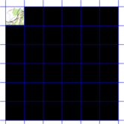
Tree Construction Methods
Brute Force
divide the map into disjoint squares, and examine each square in turn, writing down the altitude of the highest point in the square.
A
B
C
The highest point on the map is in the square with the highest altitude overall, e.g., "square #34 (1225 ft.)". We had to examine all 36 squares to find it.
With this method, we are guaranteed to find the highest point, but we are forced to examine all squares

Slide 37
Tree Construction Methods
Hill Climbing
Another strategy is to start at a random place, and then repeatedly climb uphill by doing the following:
center a square at your current position
find the highest point in that square
set your new position to that point
The process stops when the current position is the highest in the current square.

Slide 38
Tree Construction Methods
First, we select a random location on the map, and center a square around it.

Slide 39
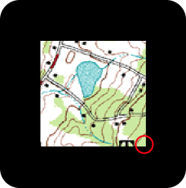
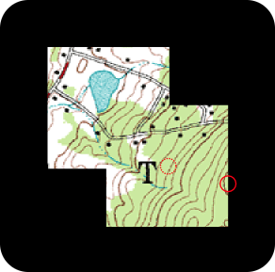
Tree Construction Methods
Find the highest point in the square.
The highest point becomes the new position, and we center a new square around it.

Slide 40
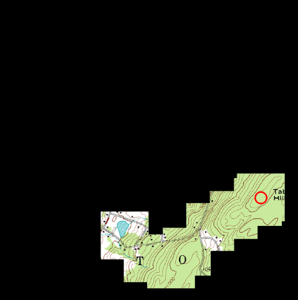
Tree Construction Methods
Repeat the process until the center of the square is the highest position.
After seven steps, we can climb no higher, so we stop. We have found a summit, and in this case it is also (close to) Taber Hill.
If we started at another square we could have ended up at Cay Hill, a peak but not the highest.
This method is thus not guaranteed to find the highest peak, but is the fastest.

Slide 41
Tree Construction Methods
Summary of the properties of the two methods:
Brute Force | Hill Climbing
Slow | Fast
Exact | Not exact
Run time grows with map size | Error risk grows with map size

Slide 42
Tree Construction Methods
What is a Good Tree?
A tree that reflects the evolutionary history of the species we are studying.
In the map analogy, the answer was simple: just read the altitude off the map.
For phylogenies, however, we cannot do this directly since the evolutionary history is mostly unknown.
We thus have to use a surrogate measure, a numerical criterion that is likely to be maximized (or minimized) in the tree that best reflects the evolutionary events.

Slide 43
Tree Construction Methods
Such criteria include:
To count the number of changes in the traits (i.e., the nucleotide or amino-acid positions) implied by each tree, and choose the tree with the fewest. The rationale is that such changes are rare, and a tree that involves more changes is less likely to be correct than a tree with fewer. This principle is called parsimony.
To use the probability of each change in the traits to derive a measure of probability for the whole tree. Then to choose the most likely or the most probable tree, given the alignment .
To sum the lengths of all branches in the tree, and choose the tree with the shortest sum. The rationale is here similar to parsimony: mutations are relatively rare, so trees with shortest overall lengths are more likely to be correct.
To compute a table of distances between all sequences, then choose the tree which most closely fits that table.
Notes:
The first two criteria look at traits, or characters, in the data, while the last two rely on some measure of distance.
Distance methods thus lose some information with respect to character methods, which do not condense the data. This condensation has the advantage of speed: distance methods are typically faster than comparable character-based methods.

Slide 44
Tree-building Methods
Brute Force method in our map analogy
Use a quality criterion i.e. number of changes or probability of each change
Are called optimizing methods.
Table: Optimizing methods and the criterion they use.
Method | Criterion
Minimum Evolution | Minimize total sum of branches
Least Squares | Maximize fit to a distance matrix
Maximum Parsimony | Minimizes number of mutations
Maximum Likelihood | Maximizes probability of alignment given tree
Bayesian | Maximizes probability of tree given alignment
Methods are exact, but they are slow

Slide 45
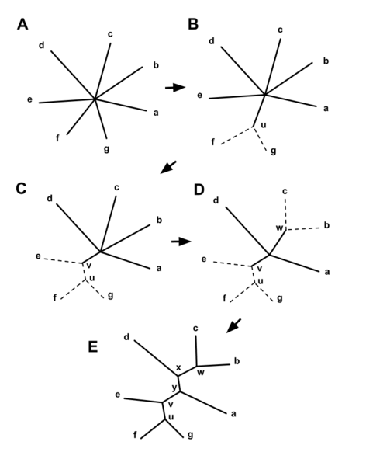
Tree-building Methods
Hill Climbing method in our map analogy
Clustering or algorithmic methods
iteratively build a tree by improving on the previous iteration.
faster than optimizing methods, but not guaranteed to find the best tree.
Most common clustering method is Neighbor-Joining (NJ).
starts with a "star" tree
all leaves are children of the same inner node
progressively joins nodes to minimize overall distance
relatively fast, but it not exact.

Slide 46
Tree-building Methods
Summary of Tree Methods
Two ways of categorizing tree-building methods:
distance-based vs. character-based
optimizing vs. clustering
 | Optimizing | Clustering
Character | Maximum parsimony, Maximum likelihood, Bayes
Distance | Minimum evolution, Least squares | Neighbor-Joining, UPGMA
UPGMA is faster than Neighbor Joining, but it assumes a molecular clock.

Slide 47
Tree-building Methods
Which method would you use on a very large number of sequences (e.g. 5,000), assuming that the molecular clock holds? Note that other criteria such as hardware, application, and so on would in absolute affect the result but these are not taken into account here.
Same question, but for a small number of sequences (say 15), with no reason to expect the molecular clock hypothesis to hold.
Notes:
UPGMA, because the number of sequences is large and the molecular clock is true by hypothesis
Maximum likelihood, the number of sequences is small enough

Slide 48
How good is my Tree? - Bootstrapping
Once we have obtained a tree, we usually want to know how reliable it is.
There are several ways of doing this, most common Felsenstein's (1985) Bootstrap test.
This procedure tests the reliability of the tree's internal nodes. It does so by repeatedly resampling, with replacement, from the original alignment. The resampling introduces some noise into each replicate. Robust clades - those which are still found despite of the noise - are deemed more likely to be correct than those who do not withstand the noise.

Slide 49
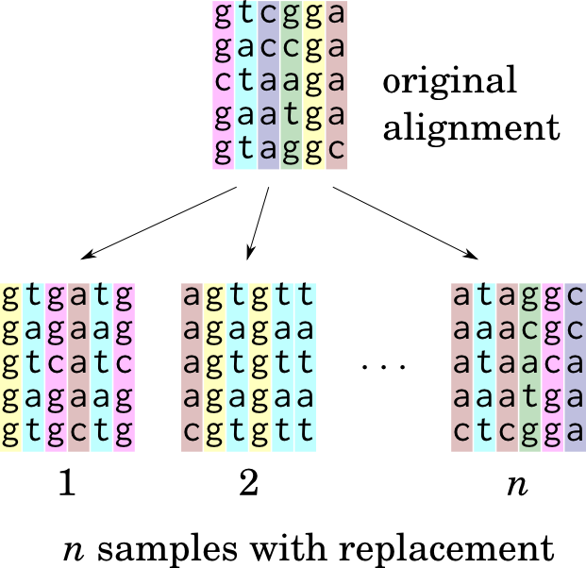
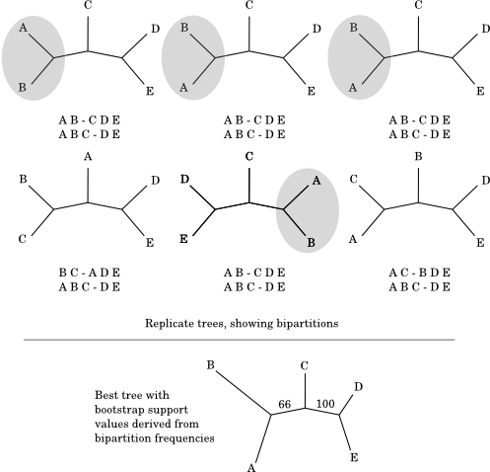
How good is my Tree? - Bootstrapping
Top: 6 replicate trees and their bipartitions. The A B - C D E bipartition is present in 4 of the trees (grey ellipses); the D E - A B C partition is found in every tree. Bottom: the best tree, with support values as percentages (66% = 4/6; 100% = 6/6)
Drawing n replicates from the original alignment (which has l = 6 columns). Note that some columns in the original may appear more than once, or not at all.
Notes:
Let us call the tree whose reliability is to be estimated the target tree. Let l be the number of columns in the alignment used to produce the target tree, and n the desired number of bootstrap replicates. Then the procedure is:
Repeat n times
Randomly draw l columns from the original alignment - this means that a column can be sampled more than once, or not at all (see Figure 12, next slide).
Compute a tree (called a replicate tree) from this sample, using the same method and parameters as for the target tree.
List all the bipartitions in the replicate tree.
A bipartition is a pair of lists of leaves separated by an inner branch (see Figure 13, next slide).

Slide 50
How good is my Tree? - Bootstrapping
For all the bipartitions in the target tree:
Count the number of replicate trees in which the bipartition appears
Divide this number by n - this number is that bipartition's support value.
Support values of >95% are generally considered significant.
The tree will be represented as follows, assuming that B is the outgroup:
/----------------------------------------+ A
|
=+ /--------------------------+ C
| |
\-------------+ 66 /-------------+ D
\------------+ 100
\-------------+ E
(the tree has been converted to a cladogram, and the outgroup is not shown).

Slide 51
How good is my Tree? - Bootstrapping
In this tree which node(s) is (are) well supported?
/-------------------------------+ POLIO3
|
| /---------------+ POLIO2
/-------+ 97 |
| | /-------+ 38 /-------+ POLIO1A
| | | \-------+ 22
=+ 76 \-------+ 72 \-------+ COXA18
| |
| \-----------------------+ COXA17
|
\---------------------------------------+ COXA1
Notes:
The sister node of COXA1

Slide 52
Summary
tree-building methods are applicable to all living organisms, with some caveats for viruses
the assumption that each species has exactly one parent may not always hold - e.g. recombination and reassortment lead to genomes with more than one parent
trees can be built using any heritable trait; in practice almost always sequences
building a tree from sequences involves alignment, choice of tree-building method, and quality assessment
optimizing methods search among all the possible trees for the one that best meets some predefined criterion
clustering methods iteratively construct a tree, improving the solution at each step until no improvement is possible
optimizing methods are exact, but slow
clustering methods are fast, but not guaranteed to find the best tree
in practice, programs tend to use both
many methods return an unrooted tree
unrooted trees can be rooted, e.g. using an outgroup.
the reliability of a tree can be evaluated by bootstrapping (among other methods).

Slide 53
Interpreting Trees

Slide 54
Classification (1/4)
Phylogenies offer an elegant solution to the problem of classifying living things, which is as old as biology.
Phylogenetic classification is different from non-phylogenetic classification:
It is refutable: a phylogeny can be declared wrong if it poorly represents the ancestry relationships in the group under study.
It generates predictions. If virus A is closely related to virus B, then any resemblance between them is likely due to shared ancestry or more rarely to convergence. Closely related species can be expected to share more than distantly related ones; if they do not, then it may indicate different selection pressure.

Slide 55
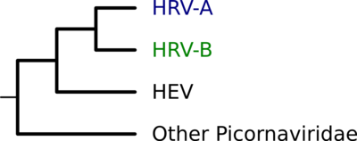
Classification (2/4)
Consider the tree of rhinoviruses and enteroviruses :
This tree is based on a phenotypic classification, which reflects the characters listed in Table 1, as well as serology.
Virus | Organ Tropism | Acid Tolerant | Optimal Temp. | Receptor
HRV-A | Respiratory tract | No | 32⁰C | ICAM-1
HRV-B | Respiratory tract | No | 32⁰C | VLDLR
HEV | Digestive tract | Yes | 37⁰C | Various
Respiratory tract viruses belong in human rhinovirus (HRV), while digestive tract viruses belong in human enterovirus (HEV).

Slide 56
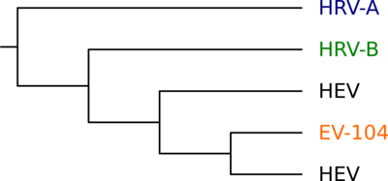
Classification (3/4)
In 2005 a new isolate (EV-104) was found in a patient with respiratory tract infection.
Based on purely phenotypic analysis this would classify the new virus as a rhinovirus
But a phylogenetic analysis shows otherwise:
HRV-A and HRV-B are not each other's closest relative, despite being respiratory tract viruses;
EV-104 falls within HEV, despite having been isolated from a patient with respiratory symptoms.

Slide 57
Classification (4/4)
This raises some questions:
What tissue did the ancestral HRV/HEV infect?
How frequently does a virus change cell tropism? (e.g. moves from infecting the digestive tract to infecting the airways, or the other way around)
What kinds of selection pressure drive the change?
The classification of all airways-infecting viruses as rhinoviruses, and of all gut-infecting viruses as enteroviruses, would have completely hidden the above issues, much less helped answering them.
In other words, when thinking about evolutionary change, phylogenetic classifications have clear advantages.

Slide 58
Reconstruction of Ancestral Sequences (1/5)
Phylogenetic trees can reconstruct ancestral sequences.
Below is tree of ten Simian Virus 40 (SV40) VP1 proteins.
amino acid at position 86 in each sequence is labeled.
The majority of sequences have an aspartic acid (D), but there is a clade ((ABU62649,(ABU86072,ABU86096))) which has glutamic acid (E) instead.

Slide 59
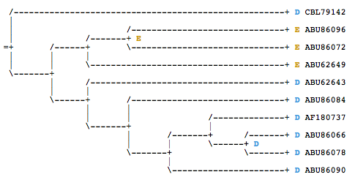
Reconstruction of Ancestral Sequences (2/5)
Can use the principle of parsimony to determine what amino acid the ancestral sequence had at that position.
Whenever two sister leaves have the same amino acid, the most parsimonious solution is to attribute that same amino acid to their parents as well - no mutation is involved.

Slide 60
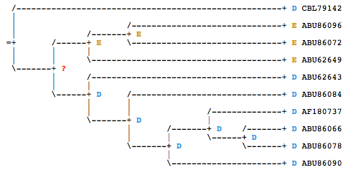
Reconstruction of Ancestral Sequences (3/5)
This reasoning indeed holds for any two children, not just two leaves.
Thus, wherever two sister nodes have the same amino acid, we can attribute that amino acid to their parent:

Slide 61
Reconstruction of Ancestral Sequences (4/5)
What was the residue at the inner node marked '?'? Since we cannot decide yet, we mark both.
Simplify tree by reducing pure clades to a leaf.
One child of root, (CBL79142) has D, the other (?) has D or E.
D is found in both children, most parsimonious tree has D at the root.
Versus
If the root has D, one (D -> E) mutation event is sufficient,
two (E -> D) mutation events would be required if the root has E.
Notes:
In summary, we have looked at one character (the amino acid at position 86) and used its value (D or E) in different sequences, together with a phylogeny of those sequences, to reconstruct its value in the ancestral sequence. Mutations (by definition) change a character's value. The value prior to mutation is called ancestral, the value after mutation is called derived.
This illustrates again how shared derived values can be used to define clades. The ancestral value for the sequences in the tree is D, so it would be wrong to lump the D sequences together only on the grounds that they share D. On the other hand, E is a derived character, so it can be used to define clades (note that this does not in itself tell us which clades exist). Finally, a character value is ancestral or derived only with respect to some other nodes. If we look at other, more distantly related SV40 sequences, we might find that the overall ancestor had, say, valine (V) at position 86. The D of the above tree would then be derived with respect to that V.
"derived sequences"?
Each leaf sequence has, at position 86, either the ancestral or a derived allele, with respect to the root. Does that mean we can call any leaf sequence "ancestral" or "derived" ? No. A sequence that has the ancestral allele at position 86 may well have a derived allele at, say, position 102. Or a position may be entirely conserved, or conversely the ancestral value may be absent altogether. In practice, all leaf sequences are a mix of ancestral and derived characters, and only the root's sequence contains (by definition) exclusively ancestral values.

Slide 62
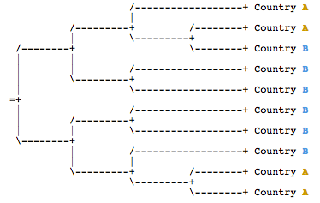
Phylogeography (1/5)
Phylogenetic trees with geographical information can trace the migration of viruses. Consider the following (hypothetical) tree of viral sequences from two countries, A and B. Can we infer where the virus originated?

Slide 63
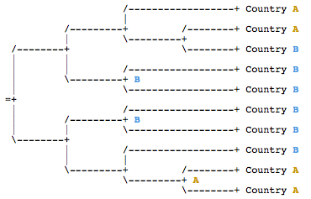
Phylogeography (2/5)
The place of isolation is either country A and country B. Using the principle of parsimony we reason that the parent of two sister isolates from the same country also came from that country:

Slide 64
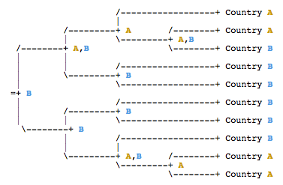
Phylogeography (3/5)
Extend the reasoning to all children, not just leaves; and in case of ambiguity we note both countries. To every parent we attribute only values found in both children.

Slide 65
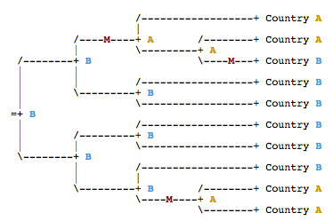
Phylogeography (4/5)
We infer that the virus probably originated in country B, and crossed into A at least twice independently, and back from A to B at least once (cross-border migrations are marked with an M in the tree below):

Slide 66
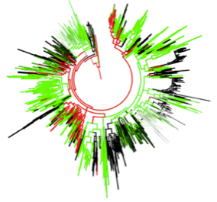
Phylogeography (5/5)
A phylogeographic tree of Hepatitis C viruses (HCV). Colour-coded branches indicate geographic information .
HCV subtype 1b hylogeographic tree.
Red: USA; Green: other developed countries; Black: developing countries
HCV 1b epidemic probably originated in developed countries, and subsequently propagated to developing countries.

Slide 67
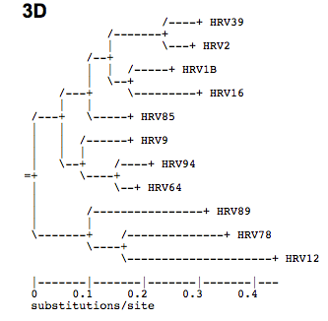
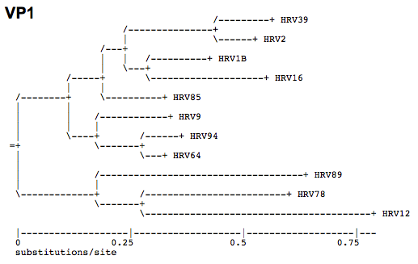
Mutation Rate (1/2)
Tree of Enteroviral protein sequences, 3D (polymerase) and VP1, (virion protein).

Slide 68
Mutation Rate (2/2)
Trees have same topology (same clades), but branch lengths are different.
3D has 0.4 substitutions / site,
VP1 has 0.75
Since the trees were made with the same viruses, the roots of both trees represent the same split, and are therefore of the same age. The leaves are all modern sequences, so each lineage (from the root to a leaf) represents exactly the same amount of time. Since the VP1 tree is almost twice as deep as the 3D tree, we must conclude that it has accumulated almost twice as many mutations
Notes:
Why are the two genes encoding these proteins evolving at different speeds? VP1 is a virion protein, exposed to the exterior. It is likely to be under pressure to change rapidly to evade recognition by the patient's immune system (hence rapidly evolving). By contrast, 3D is an RNA polymerase. It is not exposed to the immune system, and carries out a crucial enzymatic function. It is thus expected to be more conserved (hence slowly evolving).

Slide 69
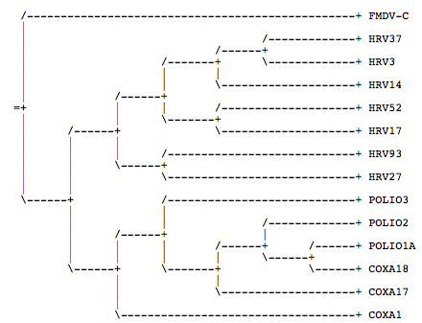
Use the Phylogeny! (1/2)
Why is a Rhinovirus next to a Poliovirus in the following tree?
Notes:
Indeed, HRV27, a rhinovirus, sits just above POLIO3, a poliovirus (lines 15 and 17). Surely the tree can't be right? But as we saw in Chapter 1, the essential information contained in a tree is the set of clades that it reveals. As the tree plainly shows, HRV27 forms a clade with HRV93; this clade in turn forms a larger clade with all the other HRVs, and the HRV clade forms an even larger clade with the Polio- and Coxsackieviruses. The closest relative of HRV27 is HRV93, not POLIO3. In fact, POLIO3 is about as removed from HRV27 as can be - only FMDV-C is more distantly related.
The error here was to fail to take the phylogeny into account altogether - instead, it was assumed that species are ordered vertically by similarity, and that similar species lie just above one another.
This is a particular case of a very widespread misconception about the living world. Until Darwin's time, it was widely thought that organisms could be unambiguously ordered by "complexity" , with simple ones like jellyfish at the bottom, and (unsurprisingly) human at the top. This was known as the "Great chain of being" or "ladder of nature" . One could choose any two species on the ladder, and one was always above the other.
If we choose two species on a phylogeny, by contrast, it may be that one is an ancestor of the other, but it is not necessarily the case. If one of the species is the root, then it is an ancestor of the other. But if e.g. both species are leaves, then neither is an ancestor of the other. Therefore, phylogenies are only partially ordered and are fundamentally incompatible with the Great chain of being. This is why the chain metaphor has been replaced by a tree metaphor, known as the Tree of Life .

