Slide 1
Multiple sequence alignment & Phylogenetics Analysis
Perform an alignment using BlastP againt the Model Organisms database.
https://blast.ncbi.nlm.nih.gov/Blast.cgi?PROGRAM=blastp
>gene
MKWVWALLLLAALGSGRAERDCRVSSFRVKENFDKARFSGTWYAMAKKDPEGLFLQDNIV
AEFSVDETGQMSATAKGRVRLLNNWDVCADMVGTFTDTEDPAKFKMKYWGVASFLQKGND
DHWIVDTDYDTYAVQYSCRLLNLDGTCADSYSFVFSRDPNGLPPEAQKIVRQRQEELCLA
RQYRLIVHNGYCDGRSERNLL

Slide 2
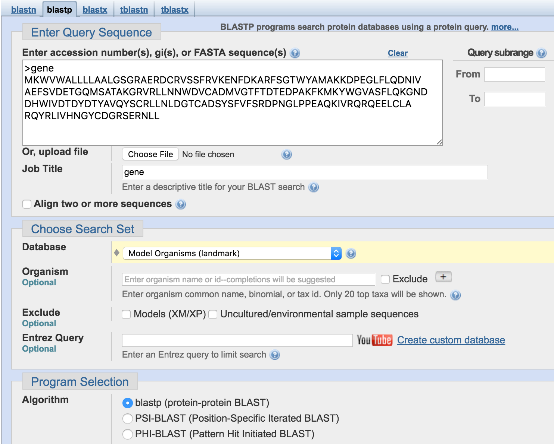
Blast form

Slide 3
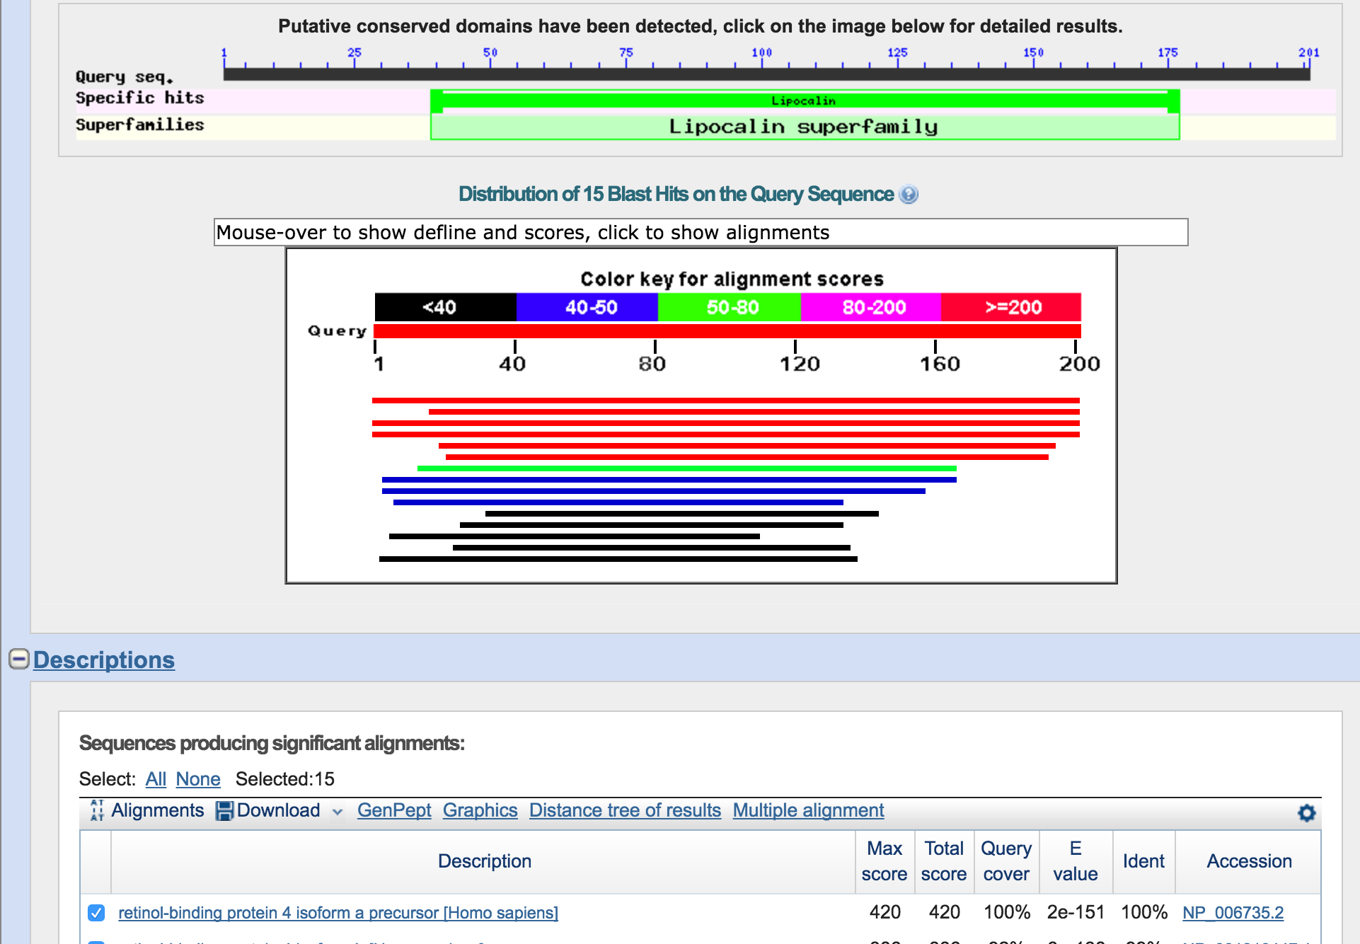
Blast based Phylogenetic Tree
Click on Distance Tree Results
to see a phylogenetic tree based on alignments.

Slide 4
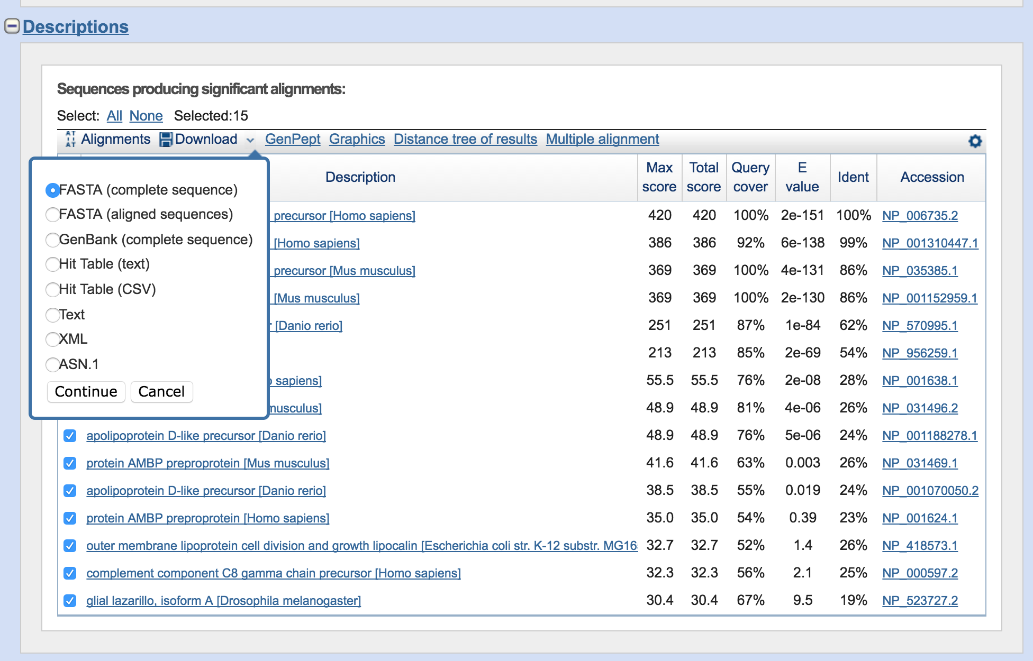
Download sequences
First click on Select “All”
Then From the Download Menu Select
“FASTA (complete Sequence)”

Slide 5
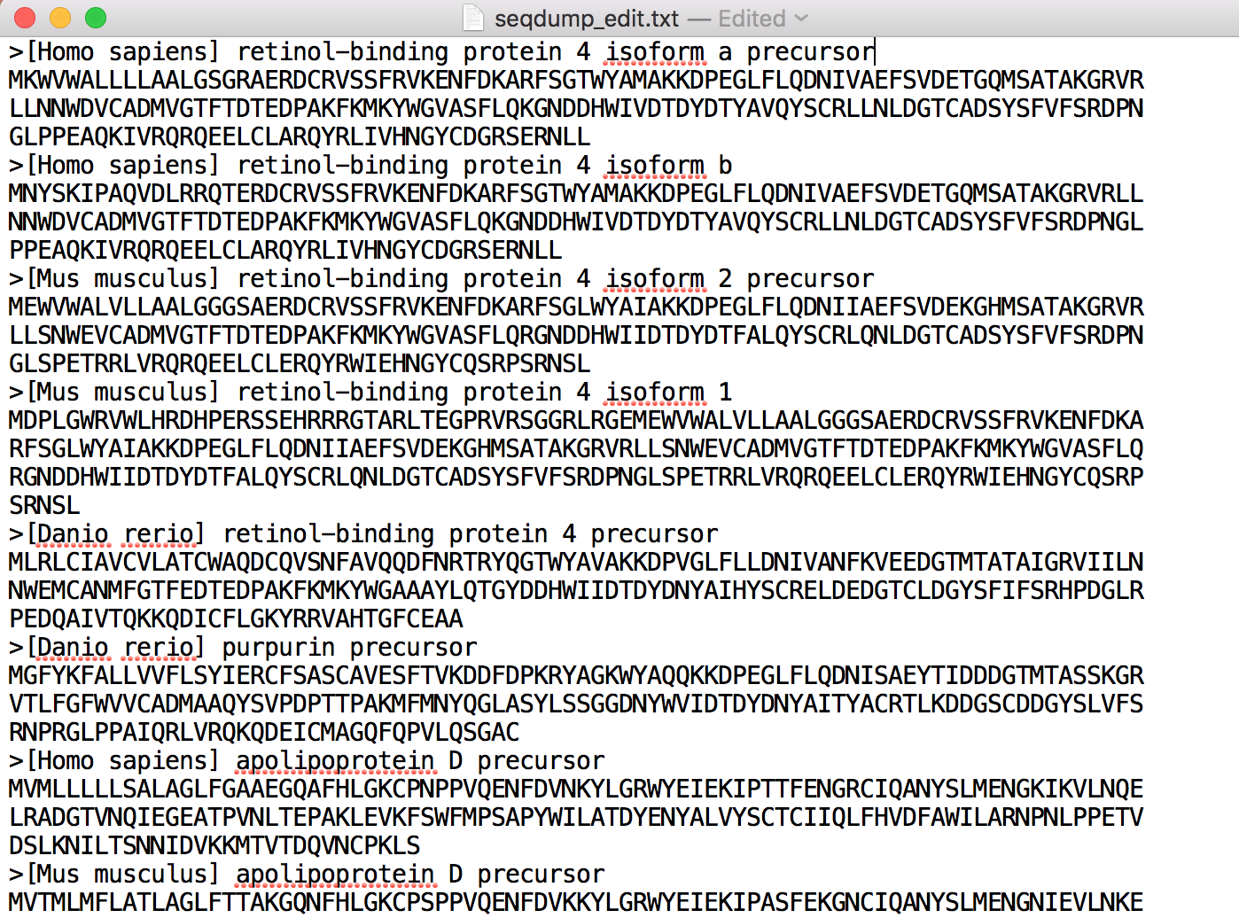
Edit the FastA file so that Species name is first and the descriptor is second. You can delete the genbank identifier.

Slide 6
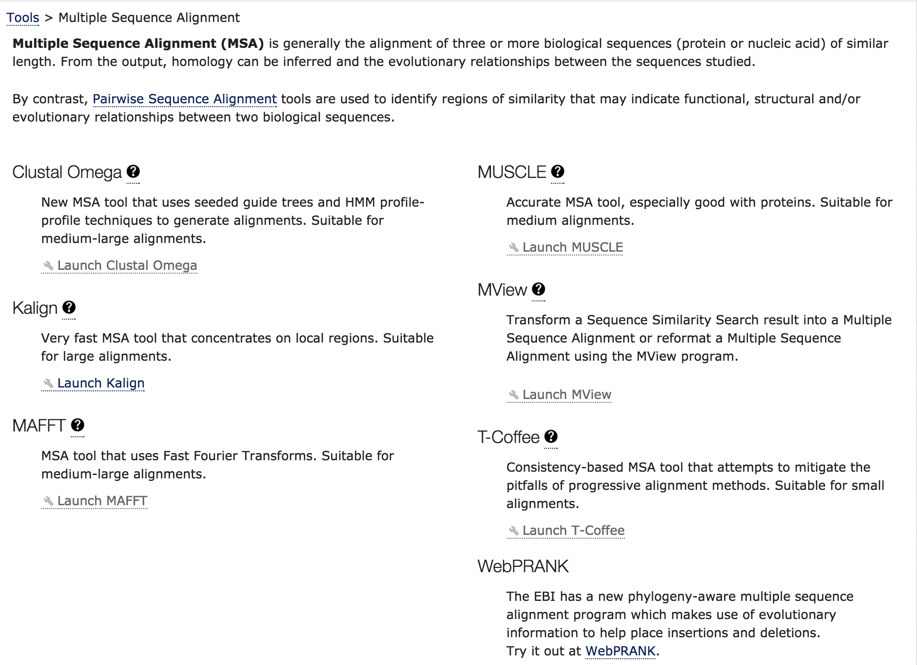
Experiment with Clustal Omega, Muscle and T-coffee. How do the results differ ?

