Slide 1
Basic Phylogenetics and Tree Building

Slide 2
Outline
Principles of Sequence Alignment
Multiple Sequence Alignment
Basics of Tree Building

Slide 3
Principles of Sequence Alignment
Alignment is the task of locating equivalent regions of two or more sequences to maximize their similarity.

Slide 4
Scoring Alignments
The quality of an alignment is measured by giving it a quantitative score.
Optimal alignment is an alignment that has the best score.
The simplest way of quantifying similarity between two sequences is percentage identity
68.75% identity (11 matches over a total of 16, including gaps)
Length of the sequence matters
30% identity over long sequence is more significant then 30% identity over short sequence

Slide 5
Dot-plot
Red dots represent identities of identical residue pairs. Pink dots are “noise”

Slide 6
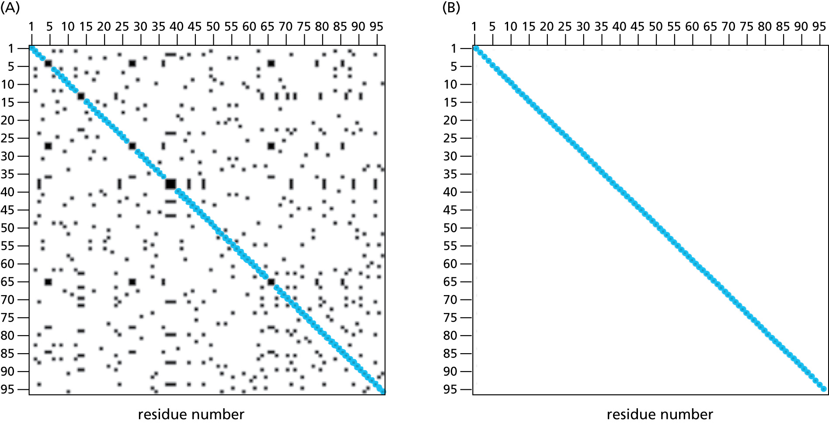
Adjusting window size and minimum score to reduce noise.
SH2 Sequence
BRCA2
Internal Repeats

Slide 7
Substitution Matrices
Substitution matrices are used to assign individual scores to aligned sequence positions
The score for this alignment is 52.

Slide 8
Amino acid substitution scoring matrices
Each cell represents the scoring given to a residue paired with another residue.
Colored shading indicates different physiochemical properties of the residues.
Yellow : small and polar
White : small and nonpolar
Red : polar or acidic
Blue : basic
Green : large and hydrophobic
Orange : aromatic

Slide 9
PAM Substitution Matrices
First developed by Margaret Dayhoff and her cowerkers in the 1960s and 1970s
Matrix is based on real data which models the evolutionary process and does not consider physiochemical similarities of proteins.
Calculated the probability that any one amino acid would mutate to another over a given period of evolutionary time which is then converted to a score.
PAM = Point Accepted Mutations – number of mutations in sequence per 100 residues. PAM250 is 250 mutations (some residues have been subjected to more than one mutation)

Slide 10
The identification of accepted point mutations

Slide 11
BLOSUM substitution matrix
In the early 1990s, sequences were clustered into group according to level of similarity.
Substitution frequencies for all possible pairs of amino acids are calculated between the clustered groups which is then used to calculate the score.
No phylogenetic trees are constructed
BLOSUM62 is derived using Blocks of peptide sequences that are 62% identity or more.

Slide 12
Derivation of the BLOSUM amino acid substitution scoring matrices.
None of the sequences are greater than 60% identical
So you perform pairwise comparisons on all (21 pairs)
Three different blocks of sequences are greater than 50% identical
So compare frequency of the amino acids at each base to other blocks
All sequences are greater than 40% identical so there is only one block.

Slide 13
Choosing a Matrix
When comparing distant protein sequences PAM 250 or BLOSUM 50 is recommended
When comparing closely related sequences, PAM120 or BLOSUM 80 may work best.
Length of the sequence should also be considered
Shorter sequences should matrices for closely related sequences
Longer sequences ( > 100 residues ) should use longer evolutionary time scale.

Slide 14
A sequence comparison:
 | A | R | N | D | C | Q | E
A | 4 | -1 | -2 | -2 | 0 | -1 | -1
R | -1 | 5 | 0 | -2 | -3 | 1 | 0
N | -2 | 0 | 6 | 1 | -3 | 0 | 0
D | -2 | -2 | 1 | 6 | -3 | 0 | 2
C | 0 | -3 | -3 | -3 | 9 | -3 | -4
Q | -1 | 1 | 0 | 0 | -3 | 5 | 2
E | -1 | 0 | 0 | 2 | -4 | 2 | 5
A
A
4
D
Q
0
D
E
2
R
R
5
Q
Q
5
C
E
-4
E
C
-4
R
Q
1
A
A
4
D
Q
0
Total score: 13
probability of (i,j) if independent
subset of the BLOSUM62 matrix
S>0: if i-to-j occurs more often than expected by chance (based on their individual frequency)
S<0: if it occurs less often
Matches have S>0: magnitude depends on how unlikely an amino acid is (rarity of occurrence in known sequences).
Mismatches:
S>0 : conservative amino acid changes
S=0 : “neutral” changes
S<0 : magnitude depends on how unlikely (infrequent, disruptive) a mismatch is.
Many assumptions go into creating matrices (“symmetry” of replacements, independence of positions for PAM, etc.)
Notes:
The matrix on the right side of the slide is a subset of the full BLOSUM62 scoring matrix. A sample sequence comparison is shown on the left. Green signifies a score of zero. Red and blue signify positive and negative scores, respectively. Note that positive scores tend to represent conservative amino acid changes.

Slide 15
Gap penalties
Gaps are needed to create good alignments between sequences
They let us account for (small) insertions and deletions.
We want to use them, but to do so sparingly, so they should have score “cost”
A sequence comparison, with a gap:
A
A
4
D
Q
0
D
E
2
R
R
5
Q
Q
5
C
E
-4
E
C
-4
R
-
D
-
D
-
R
Q
1
A
A
4
D
Q
0
Total score: 6
- [G+Ln] = -7
G = gap opening penalty = 4
L = gap extension penalty = 1
n = number of positions in gap
Exercise

Slide 16
Scoring matrices for nucleic acid sequences
Matrices derived from analysis of alignments of distince regions of the human and mouse genomes with different G+C content
37% G+C
CFTR region
47% G+C
HOXD region
53% G+C
hum16pter region
Fig. 56. From Chiaromonte et al.

Slide 17
Heuristic (vs. optimal) methods for pair-wise alignment: the BLAST family of algorithms
Given a scoring system (scoring matrix and gap penalties), alignment
can be evaluated quantitatively, and optimal alignments can be sought
with Dynamic Programming algorithms:
GLOBAL: Needleman-Wunsch-Gotoh algorithm
LOCAL: Smith-Waterman algorithm
These have high algorithmic complexity (O(N²)), and are replaced by
heuristic procedures in most practical applications.
Most commonly used: BLAST family of algorithms (local alignment).
Notes:
The possibility of gaps (or insertions) makes the number of possible sequence alignments between two sequences astronomical; therefore, the problem of sequence alignment requires powerful computational methods for its solution. Dynamic programming (DP) is an approach used to solve a wide variety of problems in computer science. Its power comes from its ability to break up a large problem into many smaller subproblems that are then solved to achieve a solution to the larger problem. In the case of sequence alignment, two sequences are broken up into ever smaller subsequences, until only single amino acids or nucleotides are being compared. Each comparison is scored, and low-scoring subsequences are removed from any additional processing, greatly decreasing the number of subsequence comparisons that is necessary to find the optimal alignment for the two sequences in question. DP algorithms are O(N²) for two sequences that have N amino acids or nucleotides. These methods are also mathematically proven to provide the optimal alignment between two sequences for a given scoring matrix. DP algorithms for sequence alignment include the Needleman–Wunsch–Gotoh algorithm for global alignments and the Smith–Waterman algorithm for local alignments. Unfortunately, DP algorithms often lack the speed necessary to perform sequence alignments over entire sequence databases. In most cases, biologists are forced to use heuristic methods for such tasks.

Slide 18
Heuristic (vs. optimal) methods for pair-wise alignment: a few more comments
The number of possible sequence alignments between two sequences is astronomical (due to an infinite number of possible indels); therefore, the problem of sequence alignment requires powerful computational methods for its solution.
Dynamic programming (DP) is an approach used to solve a wide variety of problems in computer science. Its power comes from its ability to break up a large problem into many smaller subproblems that are then solved to achieve a solution to the larger problem.
In sequence alignment, two sequences are broken up into small subsequences for comparison, and each comparison is scored. Because low-scoring subsequences are removed from further processing, this greatly decreases the number of comparisons necessary to find an optimal alignment.
DP algorithms for sequence alignment run in O(N²) time for two sequences that have N amino acids or nucleotides. These include the Needleman–Wunsch–Gotoh algorithm for global alignments and the Smith–Waterman algorithm for local alignments.
DP algorithms are mathematically proven to find an optimal alignment between two sequences for a given scoring matrix.
Unfortunately, DP algorithms often lack the speed necessary to perform sequence alignments over entire sequence databases.
In most cases, biologists are therefore forced to use heuristic methods for such tasks.
Notes:
The possibility of gaps (or insertions) makes the number of possible sequence alignments between two sequences astronomical; therefore, the problem of sequence alignment requires powerful computational methods for its solution. Dynamic programming (DP) is an approach used to solve a wide variety of problems in computer science. Its power comes from its ability to break up a large problem into many smaller subproblems that are then solved to achieve a solution to the larger problem. In the case of sequence alignment, two sequences are broken up into ever smaller subsequences, until only single amino acids or nucleotides are being compared. Each comparison is scored, and low-scoring subsequences are removed from any additional processing, greatly decreasing the number of subsequence comparisons that is necessary to find the optimal alignment for the two sequences in question. DP algorithms are O(N²) for two sequences that have N amino acids or nucleotides. These methods are also mathematically proven to provide the optimal alignment between two sequences for a given scoring matrix. DP algorithms for sequence alignment include the Needleman–Wunsch–Gotoh algorithm for global alignments and the Smith–Waterman algorithm for local alignments. Unfortunately, DP algorithms often lack the speed necessary to perform sequence alignments over entire sequence databases. In most cases, biologists are forced to use heuristic methods for such tasks.

Slide 19
FASTA
Uses location of k-tuples to speed up search.
K stands for number of residues
K is usually 1 or 2 for protein and 6 for nucleotide.
First find all k-tuples (diagonals in a dotplot)
Extend each k-tuple without gaps.
Check to see if extended segments can be joined
Take the relevant sequence and align using dynamic programming.

Slide 20
BLAST: heuristic database search using local alignment Basic Local Alignment Search Tool
…T L S R D Q H A W R L S ……
query sequence
A cartoon for BLAST
(parameters)
QW (query word), size W=3.
{ (RDQ,16) (RBQ, 14) … (REQ, 12)… (RDB, 11) }
For each QW, use the scoring matrix
to form a neighborhood NB = {all words of size W with a score > T=11}
…T L S R D Q H A W R L S ……
Find match(es) to words belonging to NB in the subject (target) sequence
…R L S R E Q H T W R S S ……
For each match, use the scoring matrix and gap penalties to produce an HSP (High scoring Segment Pair), then extend alignment on both sides, until
drop is > X, or
score goes below S_{min} (minimum hit score)
(cumulative) score
X
S_{min}

Slide 21
Steps of FASTA and BLAST algorithm
FASTA only

Slide 22
How likely is it to find a match by chance?
“Given a set of sequences NOT related to the query sequence (or even random sequences), what is the probability of finding a match with alignment score S simply by chance?"
Score will depend on:
Length and composition of the query and target sequence
Scoring matrix
Raw score (R) ⇒ Bit score (S) = (λR - ln K) / ln2
Statistical significance is given by probability and expectation values:
P-value: probability of finding one or more sequences of score >=S
by random chance
E-value: expected number of sequences of score >=S
that would be found by random chance
The lower E(hit), the more confident we are in the significance of the hit.

Slide 23
E-values
Could a given score value occur just by chance?
How large must the score be for us to be confident in the significance of a hit?
For BLAST, just like DP algorithms: given a scoring system (scoring matrix and gap penalties), an alignment (e.g. protein-protein HSP) can be evaluated quantitatively.
The score of a hit will depend on the scoring system, length and composition of the query and target sequences, and many other factors.
The Karlin-Altschul equation converts a score value, S(hit), into an expectation value, E(hit) = # of HSPs scoring S(hit) or higher that would be expected just by chance:
E(hit) = K m_{query} N_{total targets} e ^{λS(hit)}
λ = λ(scoring system)

Slide 24
Protein-Protein BLAST at NCBI
Scan a protein sequence data base (targets) for good alignments to a query sequence (e.g. MASH-1, a transcription factor regulating neural development in rats)
http://www.ncbi.nlm.nih.gov/ BLAST/
Many other BAST options available through the homepage
Algorithm parameters have defaults, but can be changed
Also, masking filters can be specified
Notes:
The BLAST homepage (http://www.ncbi.nlm.nih.gov/ BLAST/) can be found on the National Center for Biotechnology Information (NCBI) website. Sequence alignments are performed free of charge and cover all available public sequence databases. The slide shows the top of the query page for protein–protein BLAST, a program that performs sequence alignments on amino acid sequences. A query sequence is entered in the “Search” text box. For the purpose of this example, we have chosen MASH-1, a transcription factor that regulates neural development in rats. By clicking on the “BLAST!” button, the user submits the query sequence for alignment. Because the amount of time to perform a sequence alignment can vary greatly, the BLAST program gives the user an estimate for the time it will take to return the results. The results for the MASH-1 query are shown in the next slide.

Slide 25
Distribution of BLAST hits on the query sequence
Notes:
The graphical display in the slide shows the sequences that BLAST was able to align to the MASH-1 amino acid sequence. Alignment scores are represented on the color bar at the top of the figure, with scores going from low (black) to high (red). The numbered line below the color bar represents the amino acid sequence of MASH-1. Below it are various sequences from several databases that were found to align to MASH-1. The precise position of each sequence relative to the MASH-1 sequence indicates the areas of sequence similarity. The next slide shows the BLAST results in greater detail.

Slide 26
BLAST “hit list” (with more details)
Notes:
This slide shows a list of significant sequence alignments to MASH-1. Alignments were scored using the BLOSUM62 scoring matrix discussed previously. The E values, shown on the far right, measure the probability of finding a particular alignment by chance in the database being searched. As the E values approach zero, the statistical significance of the alignment increases. Note how small the E values are for the most significant alignments.

Slide 27
A pairwise alignment with MASH-1
HASH-2, a human homolog of MASH-1
“+” indicates a conservative amino acid substitution
“–” indicates gap (indel)
XXXX… indicates areas of low complexity
(filtered with RepeatMasker)
Notes:
One of the significant alignments to MASH-1 was a protein called HASH-2, a human homolog of MASH-1. The bottom of the slide shows a pairwise alignment of these two sequences that was generated by BLAST. The “Query” sequence refers to MASH-1 and the “Sbjct” sequence to HASH-2. Amino acids that are identical in the alignment are shown in the row of characters between the two sequences. Plus signs in this row indicate conservative amino acid substitutions. The minus signs in the original sequences represent deletions (or insertions). The X’s in the MASH-1 sequence are not amino acids, but instead indicate an area of low complexity. These areas typically contain short repeats and can create problems in sequence alignments because they generate high scores that do not actually reflect the biological relationship of the two sequences. An example of a low complexity area would be the amino acid sequence PPCDPPPPPKDKKKKDDGPP. The BLAST program and the NCBI website are constantly being enhanced. The reader is urged to go to the website and experiment with his or her favorite sequences.

Slide 28
Multiple sequence alignment
Uses of multiple-sequence alignments
Automated reconstruction of sequence fragments
Identification of sequence families
Phylogenetic analysis
Comparisons of many genomes (comparative genomics)
The problem of multiple sequence alignment
O(N^{M}) where N is the average sequence length and M is the number of sequences being aligned
Optimal alignments with Dynamic Programming already problematic for M=2, or small, practically unfeasible for large M
Heuristic methods are required
Notes:
So far, we have discussed pairwise sequence alignments. Alignments that involve more than two sequences are referred to as multiple-sequence alignments. Multiple-sequence alignments are necessary for phylogenetic analyses, the identification of sequence families, and the automated reconstruction of gene fragments in sequencing projects. Unfortunately, methods for finding optimal alignments (i.e., dynamic programming methods) among multiple sequences are only practical for 8–10 sequences. This is because optimal methods are O(N^{M}), where N is the average length of the sequences and M is the number of sequences. Therefore, in almost every case heuristic methods are necessary.

Slide 29
Methods for MSA
Progressive methods
Use phylogenetic trees to quantify similarities
Align most closely related sequences, and then less related ones
Downside: poor results with distantly related sequences
Iterative methods
Start with progressive alignment
Remove one sequence
Use remaining sequences and build an alignment “profile”
Realign left-out sequence using the profile
Repeat until acceptable alignment is achieved
Probabilistic methods
Hidden Markov models
Notes:
Heuristic methods for multiple-sequence alignments can be divided into progressive, iterative, and probabilistic methods. Progressive methods align the most closely related sequences first and then less related sequences. These techniques do not work well for distantly related sequences. Iterative methods often start with a progressive alignment, remove a sequence from an alignment, and then use the remaining sequences to build a “profile” of the alignment. The profile is then used to realign the sequence that had been removed. The process is then repeated until an acceptable alignment has been achieved. There are also probabilistic methods for global sequence alignments that use hidden Markov models, described in greater detail later in this chapter.

Slide 30
Multiple sequence alignment
Many different methods, many different software packages!
1) Exact
2) Progressive/hierarchical (ClustalW, ClustalX)
3) Iterative (MUSCLE)
4) Consistency (ProbCons)
5) Structure-based (Expresso)

Slide 31
Progressive MSA occurs in 3 stages
[1] Do a set of global pairwise alignments
(Needleman and Wunsch’s dynamic programming
algorithm)
[2] Create a guide tree
[3] Progressively align the sequences
Number of pairwise alignments needed
For n sequences, (n-1)(n) / 2
For 5 sequences, (4)(5) / 2 = 10

Slide 32
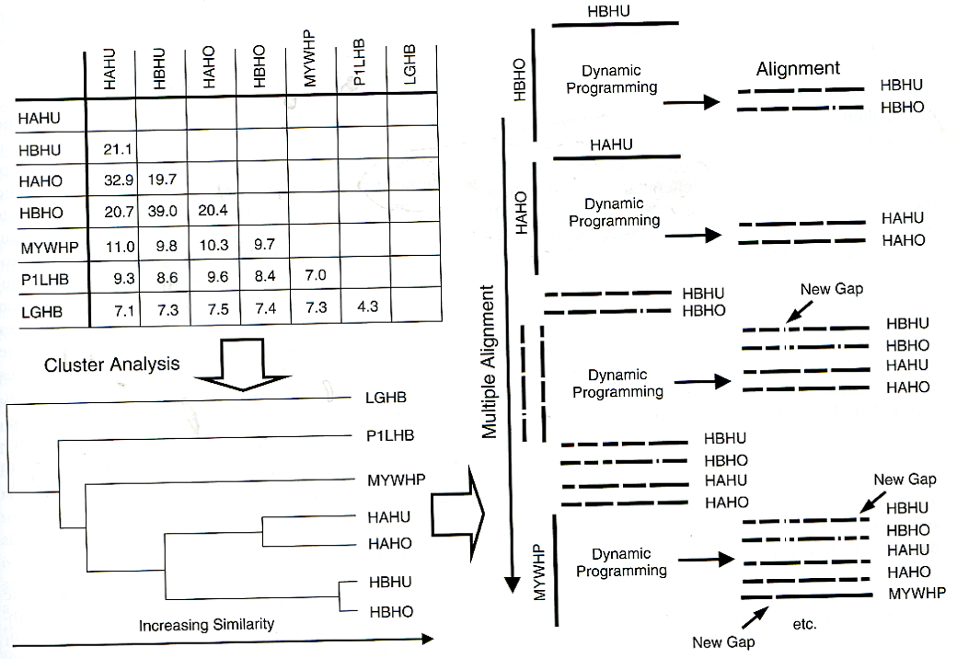
MSA: Progressive/hierarchical (ClustalW, ClustalX)
1. Perform all pairwise alignments; create distance matrix (z-scores)

Slide 33
MSA: Progressive/hierarchical (ClustalW, ClustalX)
Perform all pairwise alignments; create distance matrix (z-scores)
Create guide tree based on z-scores

Slide 34
MSA: Progressive/hierarchical (ClustalW, ClustalX)
Perform all pairwise alignments; create distance matrix (z-scores)
Create guide tree based on z-scores
Progressive alignment

Slide 35
MSA: Progressive/hierarchical (ClustalW, ClustalX)
Perform all pairwise alignments; create distance matrix (z-scores)
Create guide tree based on z-scores
Progressive alignment

Slide 36
Progressive MSA stage 3: ORDER MATTERS!
Progressively align the sequences
following the branch order of the tree
THE LAST FAT CAT THE FAST CAT THE VERY FAST CAT THE FAT CAT
THE LAST FAT CAT THE FAST CAT ---
THE LAST FA-T CAT
THE FAST CA-T ---
THE VERY FAST CAT
THE LAST FA-T CAT THE FAST CA-T ---
THE VERY FAST CAT
THE ---- FA-T CAT
Adapted from C. Notredame, Pharmacogenomics 2002

Slide 37
Progressive MSA stage 3: ORDER MATTERS!
Progressively align the sequences
following the branch order of the tree
THE FAT CAT THE FAST CAT THE VERY FAST CAT THE LAST FAT CAT
THE FA-T CAT THE FAST CAT
THE ---- FA-T CAT
THE ---- FAST CAT
THE VERY FAST CAT
THE ---- FA-T CAT THE ---- FAST CAT
THE VERY FAST CAT
THE LAST FA-T CAT
Adapted from C. Notredame, Pharmacogenomics 2002

Slide 38
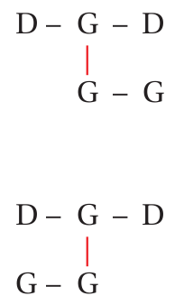
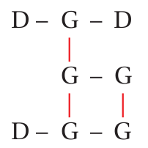
Multiple Alignment Exercise

Slide 39
Different alignment programs give different results!

Slide 40
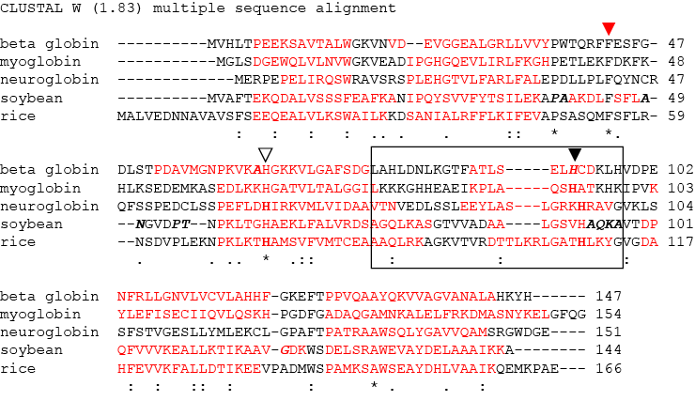
ClustalW

Slide 41
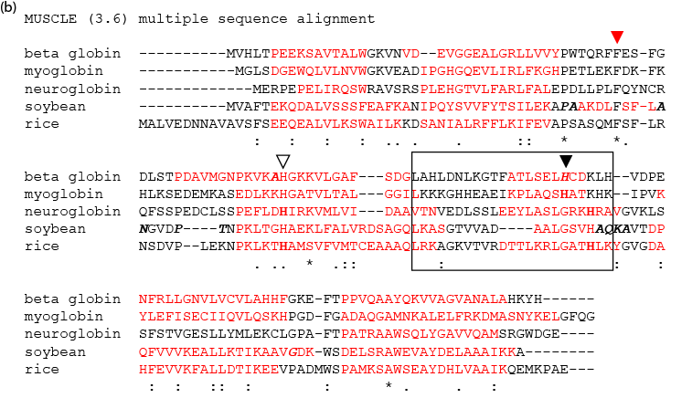
MUSCLE

Slide 42
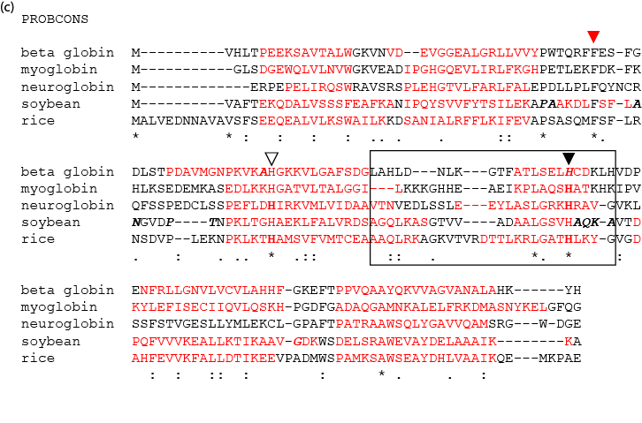
Probcons

Slide 43
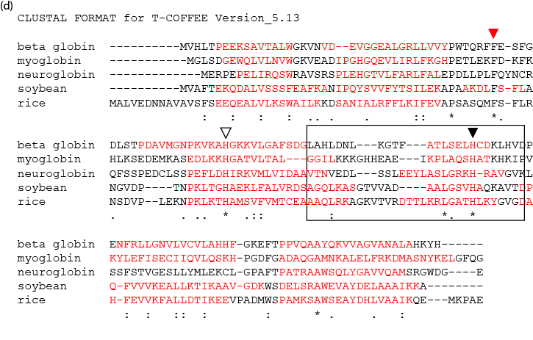
TCoffee

Slide 44
Phylogenetic trees reconstruct evolutionary relationships
Taxa – objects based on which evolutionary relationships are determined
Genes and proteins can be Taxa
Species tree – orthologous sequences are being used to determine relationship between species.
Different from when orthologous sequences are used to compare gene or proteins from gene families

Slide 45
Tree topology (the way tree looks)
Unrooted - No direction of evolution is shown
Common ancestor to all live birds is the “root” brown bird
Alive birds are shown on the leaves of the trees.
The tree is fully resolved because each internal bird has three edges
(one ancestor, two descendants) also referred to as bifurtification or dichotomous.
Internal branch points represent speciation events.

Slide 46
Different types of trees.
An additive tree – branch lengths related to evolutionary distance.
A cladogram – branch lengths have no meaning.
An ultrametric tree – additive tree where mutation rate is assumed to be constant.
An additive tree rooted with an outgroup.
Notes:
The best way to root a tree is to use an outgroup – a group of homologous sequence from species or a gene that are distantly related to the main group of species in the comparison.

Slide 47
Species tree vs Gene Tree
Species tree showing evolutionary relationship which is rooted using Hydra as an outgroup.
Gene tree showing evolutionary relationship of a Na+ K+ ion pump membrane protein. Squares represent gene duplications events.

Slide 48
A tree represented as a set of splits
At each split, the branch is a * or non-*
0.2 mutations/site

Slide 49
More definitions
Newick (New Hampshire format) – computer readable format that contains information about the tree.
Bootstrap analysis – estimates the support of the tree by repeating the construction of the tree based on different sampling
Condensed tree – branches that are not highly supported are removed
Consensus feature – feature that is always (most of the time) observed when comparing trees. The features can be summarized in a consensus tree
Strict show only those that are in all
Majority rule shows all that are present more than a threshold.

Slide 50
Tree supported by bootstrap values
Number indicates the percentage occurrence of the branch in a bootstrap test.
If 60% is the threshold a lot of the internal branches are lost resulting in multifurcating (more than three branches from a node).

Slide 51
Consensus trees show features that are consistent between trees
(B) shows the only way to represent what is happening in (A).
In (C) the 60% consensus tree only shows splits that occur > 60%. AB split happens 50% of the time where as EF happens 75% of the time.

Slide 52
p-distance = fractional alignment distance
p = D / L
D = difference in alignment
L = length of alignment
Evolutionary distance (not very accurate)
Probability of site being mutated

Slide 53
Number of observed mutations (PAM) is often less than number of mutations because of overlapping mutations.

Slide 54
Transitions and Transversions
There are twice as many
Transitions vs. Transversions
possible.

Slide 55
Average percentage of GC content in codons in bacteria.
The third position of the codon adapts the most to GC content of the genome leading to extremely high GC content in some cases.

Slide 56
All possible mutations
Blue Arrow => Transition
Red Arrow => Transversion
Synonymous=> Solid Circle
Nonsynonymous=>Dashed Circle
Stop codon => Dashed Arrow

Slide 57
Large scale genome duplications identified by looking at synonymous mutations

Slide 58
Only orthologous genes ( not paralogous genes ) should be used to construct species trees.

Slide 59
Errors due to gene loss and missing data.
Species A has lost beta gene and species
B has lost alpha gene. C an D have both.
If C alpha and D beta are not known, results would lead to wrong conclusions.

Slide 60
Reconciled tree and equivalent species tree
Reconciled trees attempt to show the gene duplication and gene loss events.

Slide 61
Identifying Paralogs and Orthologs via COGs and KOGs
Arrows represent Best Scoring Blast Hits

Slide 62
Homoplasy: sequence similarity not due to homology.

Slide 63
Number of orthologs, homologs and unique genes.

Slide 64
Tree of life taking into consideration large amounts of horizontal gene transfer
Horizontal Gene Transfer is very common in Bacteria and Archea and now that the Human Genome is sequenced we are finding Viral sequences in the human genome. The pair of genes (from the host and from the donor) are xenologous.

Slide 65
Evidence of horizontal gene transfer
Eukaryote

Slide 66
Syntenic regions
When we think about genes that are descending from the same ancestor we expect, for the most part, that the genes surrounding our gene will also be conserved.
Unfortunately chromosomal rearrangements and duplications are too common, specially in plants, and in some cases almost impossible to resolve.
But when possible we should try to pick genes that are syntenic (in the same order) as other genes so we are sure it is an ortholog.

Slide 67
Tree construction
Distance based methods
UPGMA – unweighted pair-group method using arithmetic – makes the assumption that sequences evolve at a constant and equal rate
Fitch-Margoliash – creates a unrooted additive tree
NJ - Neighbor Joining – belongs to minimum evolution methods – the most suitable tree will be the one that proposes the least amount of evolution
Maximum parsimony is also based on minimum evolution but are based on the alignment and minimize the number of mutations.
Other methods
Maximum likelihood
Bayesian methods

Slide 68
UPGMA method of constructing tree.

Slide 69
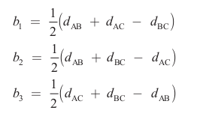
The Fitch-Margoliash method produces unrooted additive tree

Slide 71
First steps of Neighbor joining method
Once 1 and 2 are identified as nearest neighbors, they are separated from the rest.

Slide 72
Calculation for NJ

Slide 73
Calculation for NJ

Slide 74
Calculation for NJ

Slide 75
Calculation for NJ

Slide 76
Calculation for NJ

Slide 77
Calculation for NJ
5 – (29 + 26)
5-2
3 x -40/3 = -40

Slide 78
Calculation for NJ

