Slide 1
Clustering
Manpreet S. Katari

Slide 2
Steps for Clustering
Calculate distance
In order to group similar observations or attributes we need to have a way to measure their difference
Euclidean
Pearson
Spearman
Group similar observations or attributes
K-means
Hierarchical
Determine quality of clustering
Silhouette plots

Slide 3
Euclidean Distance
Geometric difference
520
Gene expression
1090
experiments
expvalues.dist<-dist(expvalues, method=“euclidean”)

Slide 4
Pearson correlation
Start with the concept of covariance
Cov_{xy}=
Implication for gene expression: the shape of gene expression responses will determine similarity
Σ (x_{i}-x)(y_{i}-y)
n
i=1
n-1
Normalize the measure by taking the variance of two measurements
VarX and VarY
√ (VarX)(VarY)
Pearson correlation has the nice property of varying between -1 and 1
-1
Gene expression
1
Σ (x_{i}-x)(y_{i}-y)
Pearson correlation coefficient
n
i=1
n-1
√ (VarX)(VarY)
experiments
expvalues.dist<-as.dist(1-cor(t(expvalues), method=“pearson”))

Slide 5
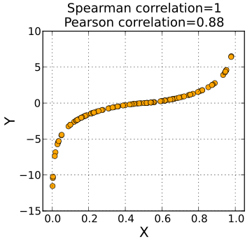
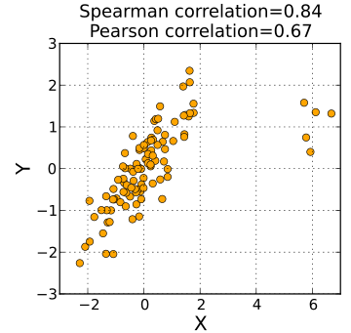
Spearman Rank Correlation
A pearson correlation of ranks.
Gives better correlation when relationship is not linear
Less sensitive compared to pearson in regards to outliers
expvalues.dist<-as.dist(1-cor(t(expvalues), method=“spearman”))

Slide 6
Hierarchical Clustering: Example
 | gene 1 | gene2 | gene 3
gene 1 | 1 | 0.5 | 0.8
gene 2 |  | 1 | 0.6
gene 3 |  |  | 1
Experiment 1
1
3
Experiment 2
Experiment 3
Experiment 4
Experiment 5
Experiment 6
Experiment 7
Experiment 8
Experiment 9
Experiment 10
Gene 1
Find cells with the shortest distance (e.g.,highest correlation)
Group the two genes
Recalculate distances from joined group to rest of matrix
Find next shortest distance
Repeat 3-4 until done
Gene 2
Gene 3
Gene 4
Gene 5
…
…
Gene 10,000
expvalues.hclust<-hclust(expvalues.dist, method=“average”)

Slide 7
Some linkage methods
Single linkage
Complete linkage
Centroid linkage
Average linkage
expvalues.hclust<-hclust(expvalues.dist, method=“average”)
expvalues.groups<-cutree(expvalues.hclust, h=0.7)
expvalues.groups<-cutree(expvalues.hclust, k=10)

Slide 8
K-means
Decide how many clusters you want, K=n, (Principal components Analysis can help)
Step 1: Make random assignments and compute centroids (big dots)
Step 2: Assign points to nearest centroids
Step 3: Re-compute centroids (in this example, solution is now stable)
Optimize by maximizing distance between groups, minimizing distance within groups
expvalues.kmeans<-kmeans(expvalues.dist, 10)

Slide 9
K means in action: creates round clouds

Slide 10
K-means weaknesses: can give you a different result each time with exactly the same data

Slide 11
Interpreting Clusters
Take Home Message: You Can Cluster Anything You Want and Anything in the Right Format Will Cluster. It Doesn’t Make it Relevant.

Slide 12
Judging the Quality of a Cluster
The idea is to classify distinct groups: other methods seek to directly optimize this trait in classification

Slide 13
Measuring the Quality of Clusters
This guy has a low a_{i} and a big b_{i} so a high Silhouette value
Will lead to low or negative Silhouette values
Silhouette Width
Sil_{i} = (b_{i}-a_{i})/max(a_{i},b_{i})
a_{i}-average within cluster distance with respect to gene i
b_{i}-average between cluster distance with respect to gene i
expvalues.sil = silhouette(expvalue.groups, expvalues.dist)

Slide 14
Silhouette Plot
plot(expvalues.sil, col=”blue")

Slide 15
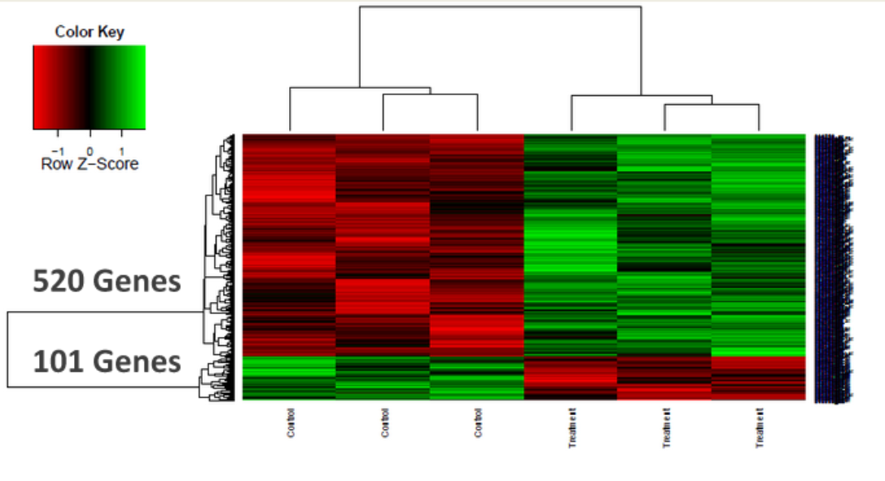
HeatMaps
Heatmaps allow us to visually inspect the separation of genes based on the clustering method used in terms of their expression values.
The default values of how the heatmap performs clustering can be changed by creating new functions that calculate distance and also perform clustering.

Slide 17
Genome wide analysis results in gene lists
When analyzing high-throughput data, like Microarray experiment, the end result is often a list of genes.
Differentially expressed genes.
Cluster of highly correlated genes.
A natural next step is to identify the commonality between the genes in the list.
Similar annotations
Same Pathway
Components of a Protein Complex

Slide 18
Gene lists as a discovery tool
Depending on how the gene list was created, the genes can be used for discovering new things
For example if you have a cluster of highly correlated genes. One can look for novel Transcription Factor Binding sites by aligning the promoter regions of the genes in the cluster.
Many genes in the genome are still annotated as “unknown function”. Finding an “unknown” gene in a list consisting of genes only up-regulated by a given treatment allows the biologists to provide a putative function for the unknown gene.

Slide 19
Gene Set Enrichment
Often when we characterize this list of genes, we use statistics to show that the property or annotation is significantly over-represented compared to if the list was created randomly.
Two of the common statistical methods are :
Hypergeometric Test
Fisher’s exact test.

Slide 20
Gene Ontology
“The Gene Ontology (GO) project is a collaborative effort to address the need for consistent descriptions of gene products in different databases.”
“The GO project has developed three structured controlled vocabularies (ontologies) that describe gene products in terms of their associated biological processes, cellular components and molecular functions in a species-independent manner.”
“A gene product might be associated with or located in one or more cellular components; it is active in one or more biological processes, during which it performs one or more molecular functions.”

Slide 21
Go is a directed acyclic graph

Slide 22
Categorical Data Analysis
Biomedical data are often represented in groups of more than on category.
Often we want to know if there are any associations with the between the categories (for example age and ER)
Chi-square test can be used to test the association. The Null hypothesis here is that there is no association.
In the case where values in the table are less than 10, then fisher’s exact test is more appropriate

Slide 23
Chi-Square Test
First step of Chi-Square test is to determine the expected number for each count.
For the value in the table at position [1,1], the expected value is
(sum(row1) * sum(col1)) / totalcount
The chi-square statistic is
Σ ( E – O )^2 / E
P-value can be determined by using the degree of freedom
(number of rows – 1 x number of columns – 1)

Slide 24
Fisher’s Exact test
Fisher’s Exact test can be used regardless of the size of the values, however it becomes hard to calculate when samples are large or too well balanced so chi-square test can be used here.
Fisher showed that probability of obtaining such values was given by hypergeometric distribution
P= (A+B)!(C+D)!(A+C)!(B+D)! / A!B!C!D!N!
 | Factor1 Level1 | Factor1 Level2
Factor2Level1 | A | B | A+B
Factor2Level2 | C | D | C+D
 | A+C | B+D | A+B+C+D

Slide 25
Hypergeometric Test
The hypergeometric distribution is a discrete probability distribution that describes the number of successes in a sequence of n draws from a finite population without replacement.
Think of an urn with two types of marbles, blue(5) and red(45) where blue is success and red is failure. Stand next to the urn with your eyes closes and select 10 marbles without replacement. What is the probability that 4 of the 10 will be blue?
http://en.wikipedia.org/wiki/Hypergeometric_distribution

